Slide 1
MAKING THE INVISIBLE VISIBLE
GREEN FLUORESCENT PROTEIN

Slide 2
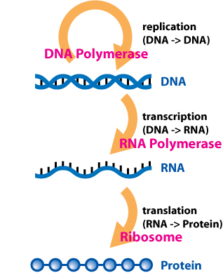
From gene to trait
Attribution: Dhorspool at en.wikipedia

Slide 3
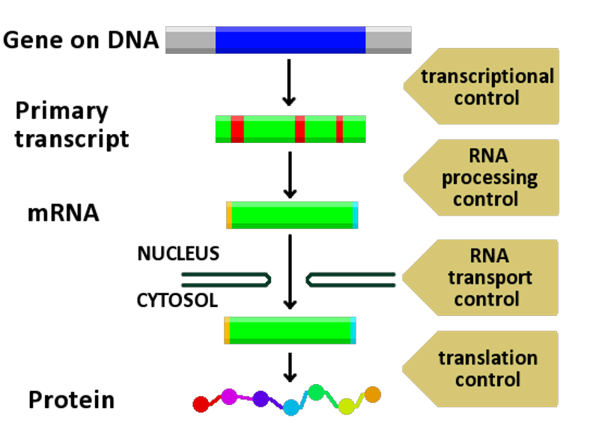
Gene Regulation
http://en.wikipedia.org/wiki/File:Gene_expression_control.png

Slide 4
Proteins provide structure and function
Intracellular structures
Extracellular structures
Signaling molecules
Hormones
Receptors
Enzymes
Gene regulators
Pigments

Slide 5
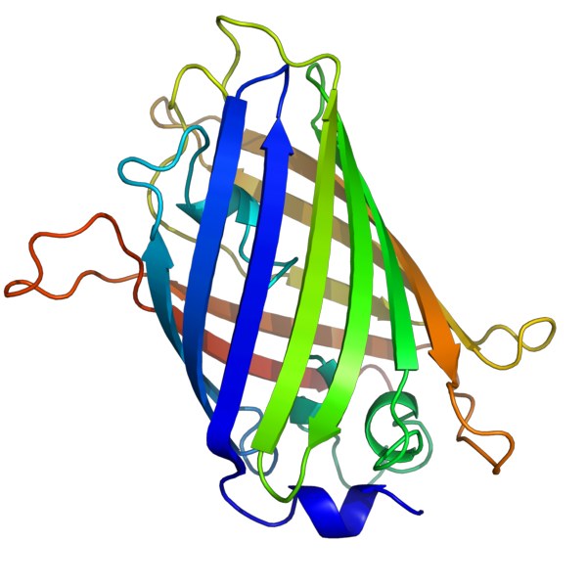
GFP is a protein

Slide 6
Genetic Engineering and GFP
Make a copy of the gene for GFP
Modify it
Attach a sequence to it that
regulates a gene of interest
moves a protein to a particular organelle
Attach it to the gene for a known protein
Insert the sequence into a cell
GFP reports cellular or gene activity!

Slide 7
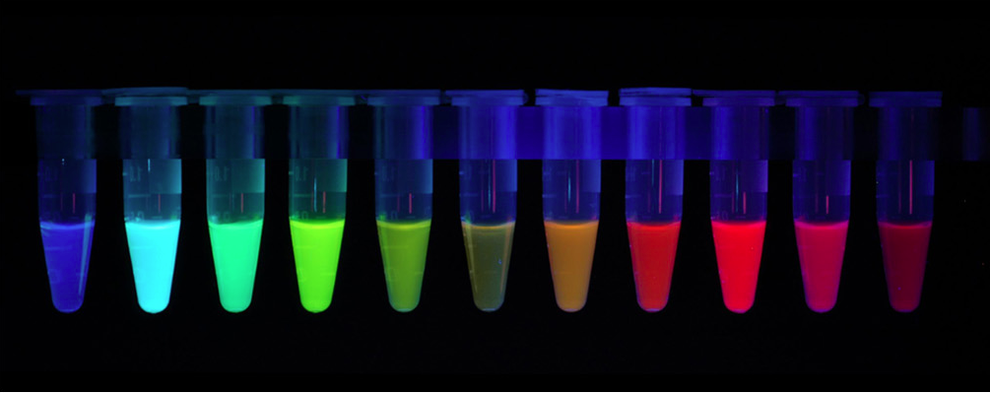
Engineering GFP itself
From A Nobel for GFP, By Michael Eisen | October 8, 2008
http://www.michaeleisen.org/blog/?p=59

Slide 8
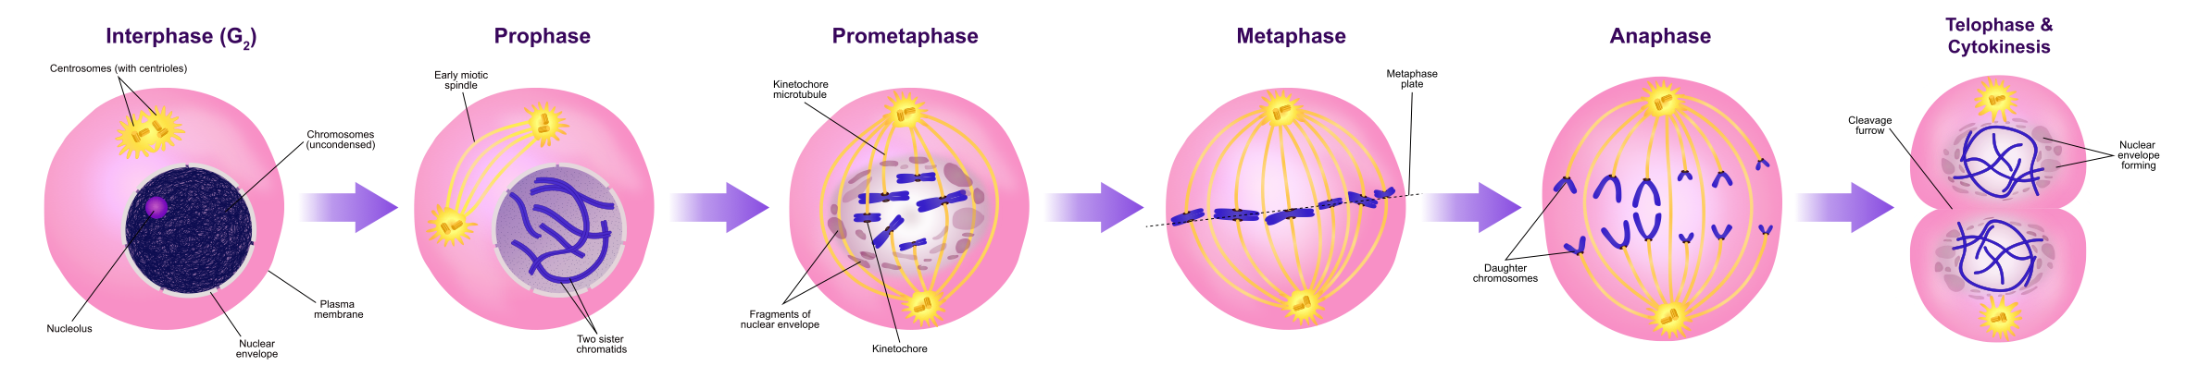
Mitosis
By Ali Zifan - Own work; Used information from:Campbell Biology (10th Edition) by: Jane B. Reece & Steven A. Wasserman.and Nature.com., CC BY-SA 4.0, https://commons.wikimedia.org/w/index.php?curid=49721676

Slide 9
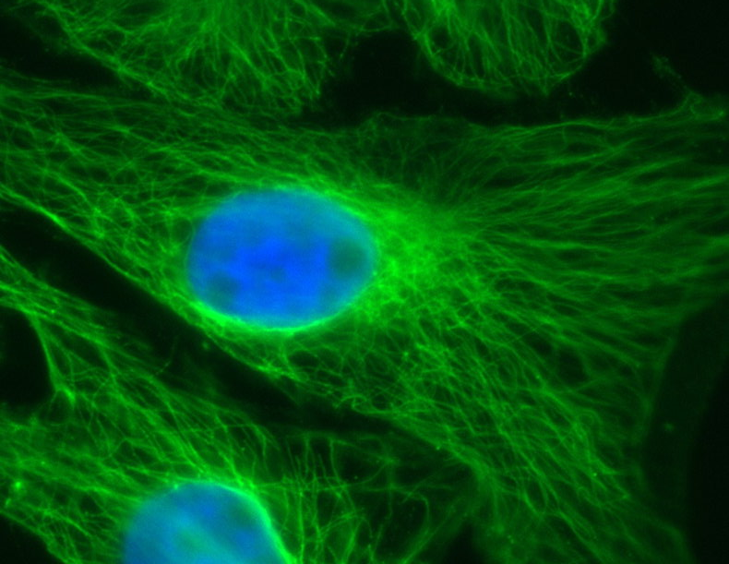
LLCPk cells
Pig kidney epithelial cells

Slide 10
Phase contrast microscopy
Find cells in phase microscopy
Find a field of view with lots of cells
Switch between “eye” and “side”
Take an image.
Save to desktop

Slide 11
Fluorescence microscopy
Turn on Xenon lamp
See microtubules and myosin with LP filter
Microtubules with B filter
Myosin with G filter
Everybody look!

Slide 12
Taking a color image
Focus carefully
Take and save an image through B filter.
DO NOT MOVE SLIDE OR TOUCH FOCUS KNOB
Take and save another image through G filter
Open both images
Image/color/merge
Choose correct channels
Save as onto the desktop

